Slide 1
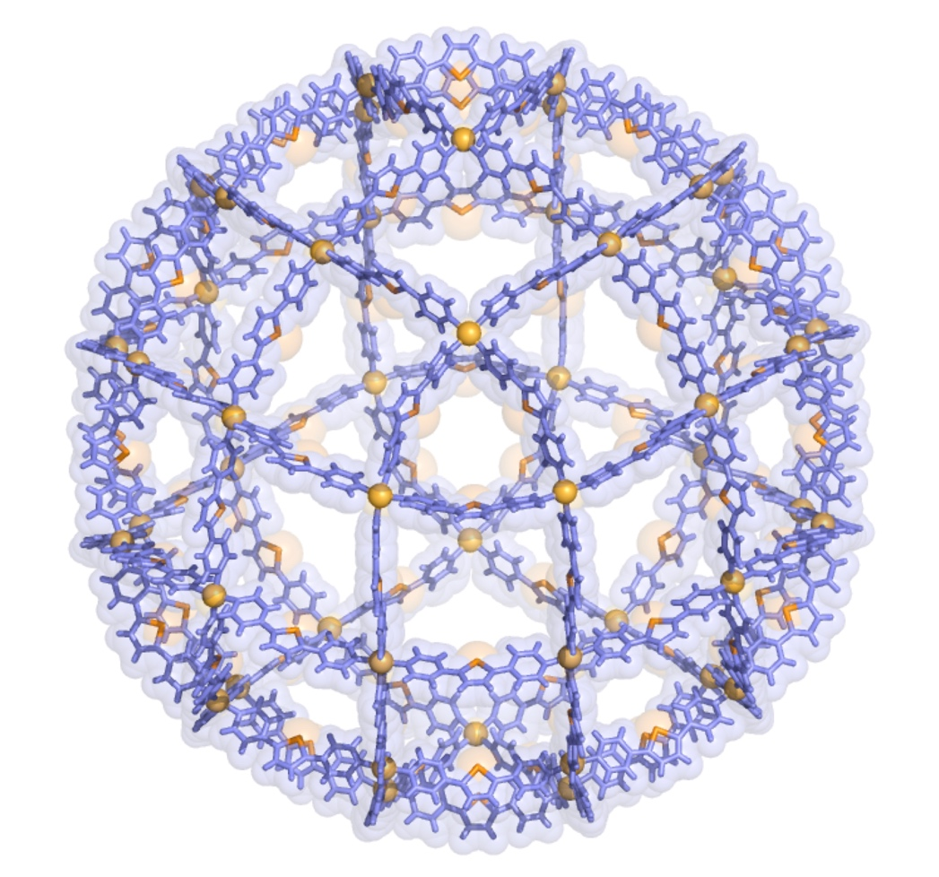
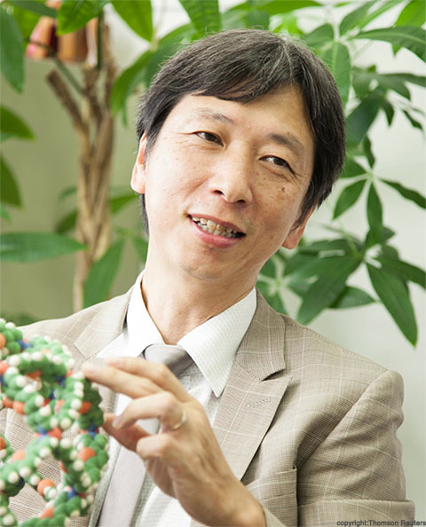
Coordination Self-Assembly:
From Origins to the Latest Advances
Prof. Makoto Fujita – Institute of Advanced Studies, University of Tokyo
February 10th 14:30, Ue4 lecture room N “Toso Montanari”
Molecular self-assembly based on coordination chemistry has made an explosive development in recent years. Over the last >30 years, we have been showing that the simple combination of transition-metal’s geometry (typically, a 90 degree coordination angle of Pd(II) center) with organic bridging ligands gives rise to the quantitative self-assembly of nano-sized, discrete organic frameworks. Representative examples include square molecules (1990), linked-ring molecules (1994), cages (1995), capsules (1999), and tubes (2004) that are self-assembled from simple and small components. Originated from these earlier works, current interests in our group focus on i) molecular confinement effects in coordination cages, ii) solution chemistry in crystalline porous complexes (as applied to “crystalline sponge method”),^{[1]} and iii) and giant self-assemblies,^{[2]} as disclosed in this lecture.
Figure 1. X-ray structure of M₄₈L₉₆ complex.
^{[1]} Nature 2013, 495, 461; ^{[2]} Nature 2016, 540, 563.
Prof. Makoto Fujita is a Distinguished Professor at the University of Tokyo.
His research interests include: (i) Coordination Self-Assembly: Construction of nano-scale discrete frameworks, including M_{n}L_{2n} Archimedean/non-Archimedean solids, by transition-metal ions induced self-assembly; (ii) Molecular Confinement Effects: Developing new properties and reactions in the confined cavities of self-assembled coordination cages; (iii) Crystalline Sponge Method: Single-crystal-to-single-crystal guest exchange in the pores of self-assembled coordination networks, applied to a new X-ray technique that does not require the crystallization of target compounds.

